Slide 1


Bank of Baroda Hackathon - 2022
Technology Partner
Your Team Name : SECURITAS OUTSHINE
Your team bio :
KANISHKA D
MADANIKA G K
SUWETHA R
VAISHALI T J
Date :

Slide 2
ALTERNATE AUTHENTICATION
Nowadays ,passwords can be easily cracked,and they are not secured.
To try and make password more secure,consumers are asked to make them more complex,by using numbers,uppercase,lowercase letters and special characters.This makes the people hard to remember.
If suppose a strangers person knows our password they can hack it easily.
Our intension is about,avoiding those consequences occurred, by using biometric authentication like iris and fingerprint scanner.
It adds next level security.

Slide 3
User Segment & Pain Points
Both clients and banks need an easy , secure , fast and convenient way to ensure the security of transactions as passwords are not reliable or secure in practice
The driving factor for adoption of biometrics in banking transaction is that it shortens authentication times across both channels and devices
Customers benefit is they need not to carry accessible cards for all the places
Work stress is less for bank sectors
No complexity in choosing a password

Slide 4
Pre-Requisite
IF ANYONE ACCESS OUR BANK DETAILS:
Using Calls-A precautionary calls alert to us ,if anybody access our account
Using Messages-safeguard messages awake us
Using OTP-One Time Password are also used to make us lively
Using Cards- Using of identification cards we may access our accounts without passwords

Slide 5
Azure tools or resources
Azure portal Azure cloud shell Azure power shell Azure CLI

Slide 6
Any Supporting Functional Documents
No physical contact when scanning.
For fingerprint,we use verihand technology method that creates pure digital identity.
This technology is total contactless and hygienic scanning process.
Unlike other biometrics,our solution doesn’t leave fingerprint traces and handprint traces in any surface that can be copied.

Slide 7
Key Differentiators & Adoption Plan
Strong authentication
There is no need to remember our password or pin numbers
No need to carry any accessories
Say goodbye to passwords
Non-transferable
Biometric payments is said to be 99.99% accurate

Slide 8
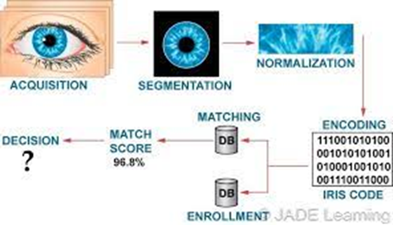
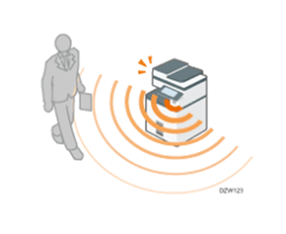
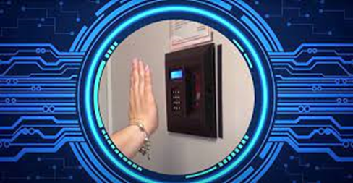
GitHub Repository Link & supporting diagrams, screenshots, if any

Slide 9
Thank You
Team member names:
KANISHKA D
MADANIKA G K
SUWETHA R
VAISHALI T J
URL:https://github.com/Passwordlesssecuritas/Securitas-Outshine.git

